Slide 1
SLLGEN DEMO
Statement ::= { Statement ; Statement }
::= while Expression do Statement
::= Identifier := Expression
Expression ::= Identifier
::= (Expression - Expression)

Slide 2
(define-datatype statement statement?
(compound-statement
(stmt1 statement?)
(stmt2 statement?))
(while-statement
(test expression?)
(body statement?))
(assign-statement
(lhs symbol?)
(rhs expression?)))

Slide 3
(define-datatype expression expression?
(var-exp
(var symbol?))
(diff-exp
(exp1 expression?)
(exp2 expression?)))

Slide 4
{x := foo; while x do x := (x - bar)}
#(struct:compound-statement
#(struct:assign-statement x #(struct:var-exp foo))
#(struct:while-statement
#(struct:var-exp x)
#(struct:assign-statement x
#(struct:diff-exp
#(struct:var-exp x)
#(struct:var-exp bar)))))

Slide 5
Specifying Scanners
Scanner-spec ::= ({Regexp-and-action}∗)
Regexp-and-action ::= (Name ({Regexp}∗) Action)
Name ::= Symbol
Regexp ::= String | letter | digit | whitespace | any
::= (not Character) | (or {Regexp}∗)
::= (arbno Regexp) | (concat {Regexp}∗)
Action ::= skip | symbol | number | string

Slide 6
(define scanner-spec-a
‘((white-sp (whitespace) skip)
(comment ("%" (arbno (not #\newline))) skip)
(identifier (letter (arbno (or letter digit))) symbol)
(number (digit (arbno digit)) number)))

Slide 7
Specifying Grammars
Grammar ::= ({Production}∗)
Production ::= (Lhs ({Rhs-item}∗) Prod-name)
Lhs ::= Symbol
Rhs-item ::= Symbol | String
::= (arbno {Rhs-item}∗)
::= (separated-list {Rhs-item}∗ String)
Prod-name ::= Symbol

Slide 8
(define grammar-a1
‘((statement
("{" statement ";" statement "}")
compound-statement)
(statement
("while" expression "do" statement)
while-statement)
(statement
(identifier ":=" expression)
assign-statement)
(expression
(identifier)
var-exp)
(expression
("(" expression "-" expression ")")
diff-exp)))

Slide 9
Using SLLGEN
(define scanner-spec-1 ...)
(define grammar-1 ...)
(sllgen:make-define-datatypes scanner-spec-1 grammar-1)
(define list-the-datatypes
(lambda ()
(sllgen:list-define-datatypes scanner-spec-1 grammar-1)))
(define just-scan
(sllgen:make-string-scanner scanner-spec-1 grammar-1))
(define scan&parse
(sllgen:make-string-parser scanner-spec-1 grammar-1))

Slide 10
הדגמת השימוש ב-SLLGEN
בסביבת Racket

Slide 11
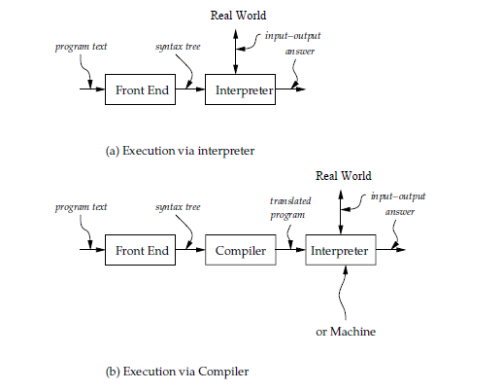

Slide 12
Parse-expression
Concrete
Syntax
Abstract
Syntax
Unparse-expression
Interpreter
Results

Slide 13
קומפילציה על קצה המזלג
Source code
(character stream)
if (b == 0) a = b;
Lexical analysis
Token stream
if
(
b
==
0
)
a
=
b
;
Parsing
if
==
=
;
Abstract syntax tree
(AST)
b
0
a
b
if
Semantic Analysis
boolean
==
int
Decorated AST
=
;
int b
int 0
int a
lvalue
int b

Slide 14
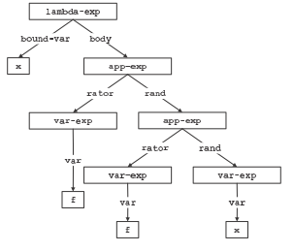
Figure 2.2: (lambda (x) (f (f x)))

